Slide 1
PlayGo!
Group #31
Carlos Lawrence
Parth Mishra
David Brunelle

Slide 2
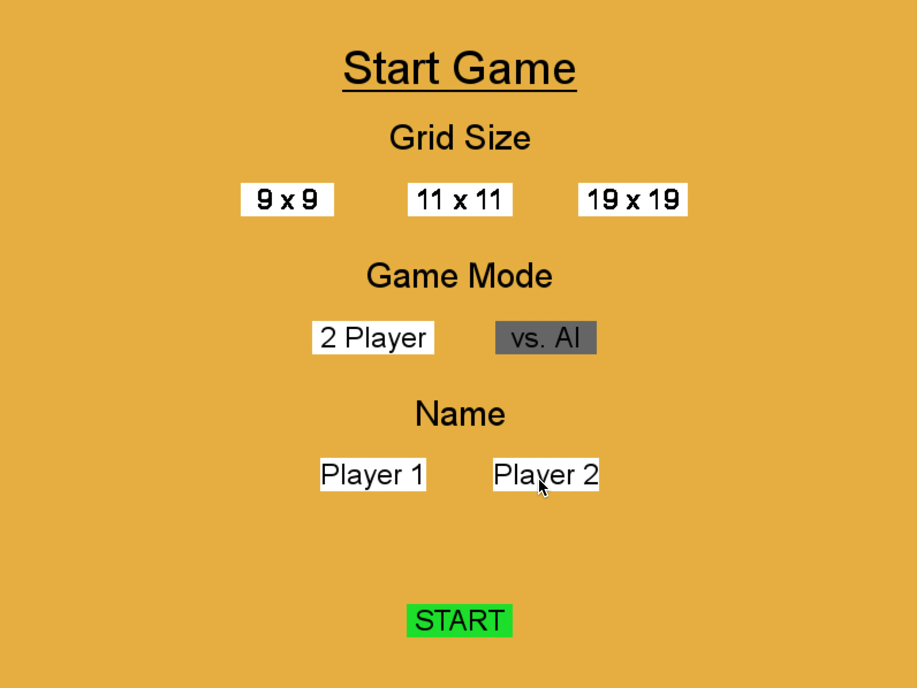

Slide 3
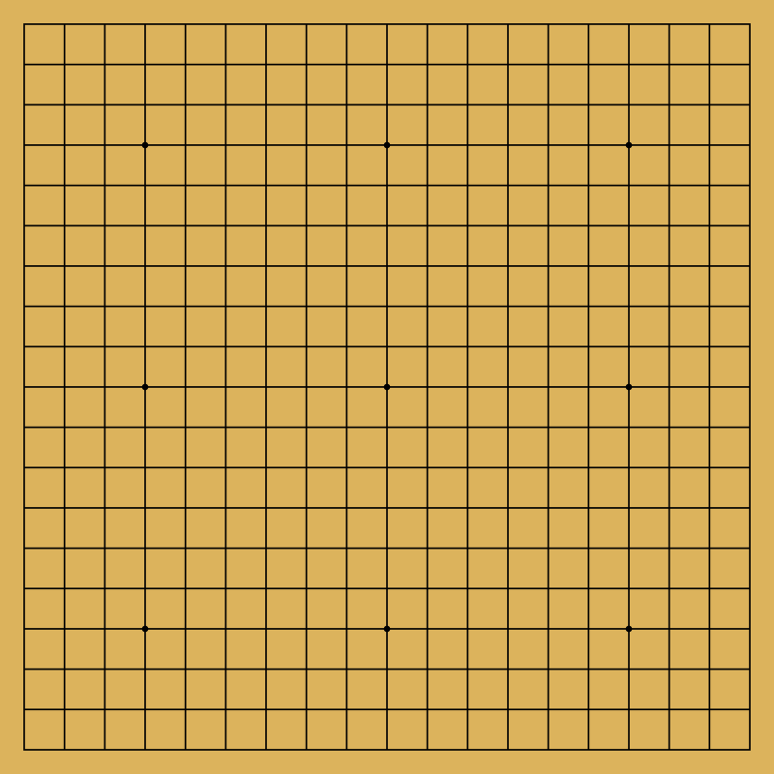
Basics of Go
Basic rules:
2 Players – black and white stones
Can place a piece anywhere on the board
Black goes first
Played on 9x9, 11x11, 19x19

Slide 4
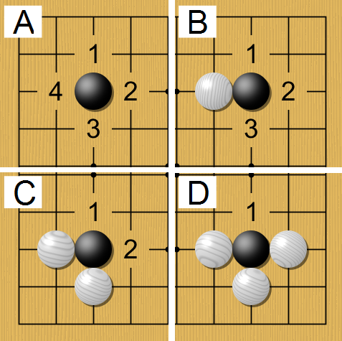
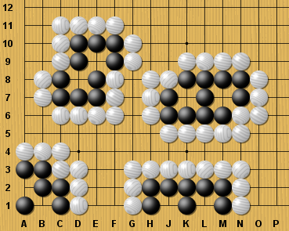
Captures
Pieces have liberties
Surround all liberties to capture
Two eyes cannot be captured
Adjacent stones mix liberties
Captures precede liberties

Slide 5
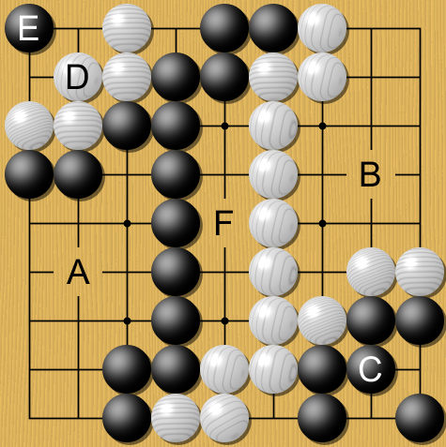
Territories and Scoring
Count empty points stones surround
Points enclosed by both players is awarded to neither
Count the territories and captures

Slide 6
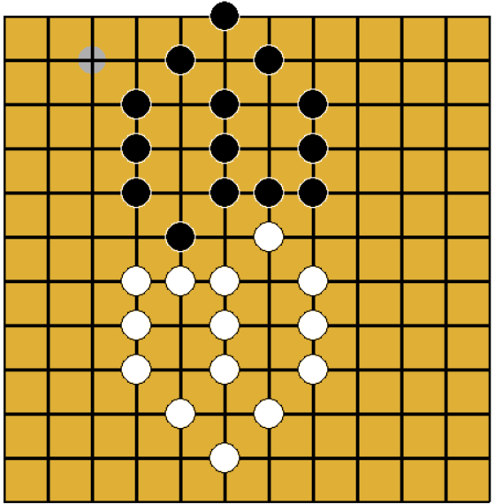
Singleton
Grid
Python implementation of singleton
Why we needed to use singleton
Notes:
Intent of singleton:
– Ensure a class has only one instance, and provide a global point of access to it.
– Encapsulated "just-in-time initialization" or "initialization on first use” (lazy initialization)
- We don’t want more than one grid

Slide 7

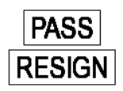
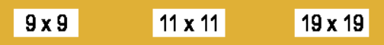
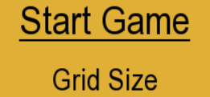

Prototype
Buttons
Text Labels
Notes:
Intent of prototype:
– Allows for creation of an object based on an existing object, rather than using a class as a template
– May simplify creation of application-specific objects using a particular framework

Slide 8
Images
By Scsc (Own work) [CC BY-SA 3.0 (http://creativecommons.org/licenses/by-sa/3.0)], via Wikimedia Commons
By Gringer (talk) - Originally based on File:Blank_Go_board.png, but SVG has since been manually rewritten, Public Domain, https://commons.wikimedia.org/w/index.php?curid=5989973
By Медведев (CGoban) [Public domain], via Wikimedia Commons
By Scsc - Own work, CC BY-SA 3.0, https://commons.wikimedia.org/w/index.php?curid=15649052

